Slide 1
Simple Map Using A* Algorithm
Sararah Mahjabin
ID:18101067

Slide 2
Contents:
Introduction.
Objective.
Designed Map.
Search tree of the Map.
Implementation
Result Analysis.
Conclusion.

Slide 3
Introduction:
A * algorithm is a searching algorithm that searches for the shortest path between the initial and the final state.
In this project, I have designed a small map from “My Home (Jigatola) to University of Asia Pacific (Uap)”. Using this map, I have developed a search tree. Then implemented the map in a python program using A* search algorithm for getting an optimal solution, which will show the shortest path and lowest path cost.

Slide 4
Objective:
This Project will help;
To find the shortest path from my home to uap.
To find the lowest path cost for traveling the path.

Slide 5
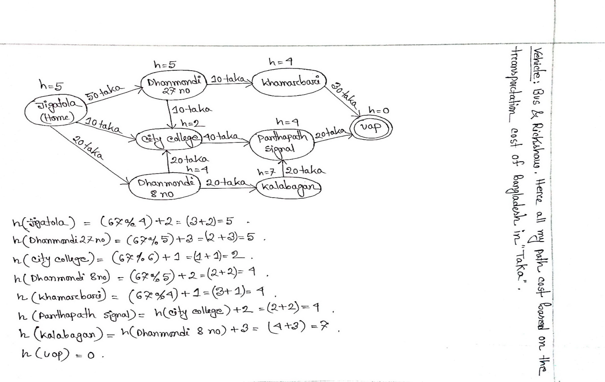
Designed Map:

Slide 6
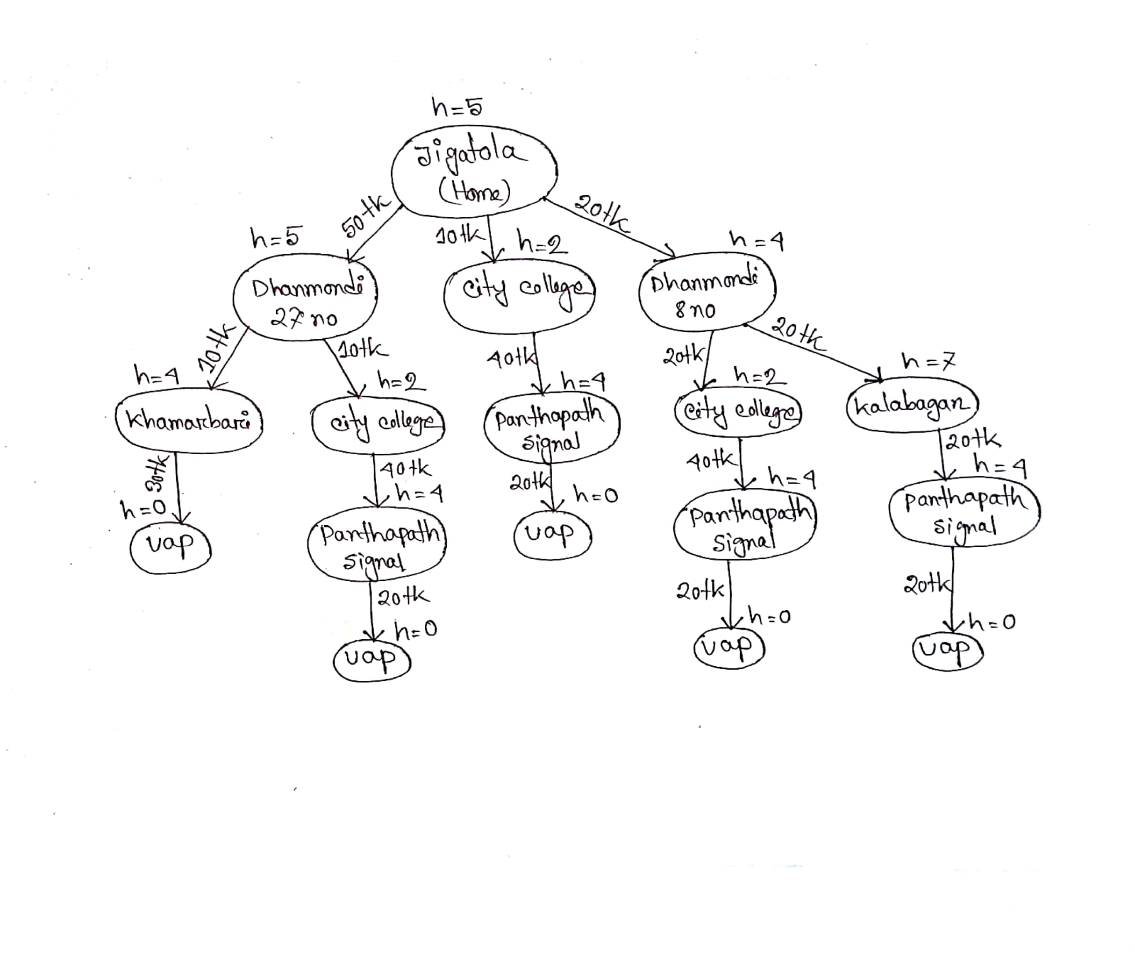
Search Tree of the Map:

Slide 7
Implementation

Slide 8
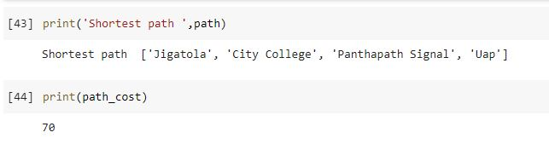
Result Analysis:

Slide 9
Conclusion:
This project is helpful to find the optimal solution of any map using A* search algorithm. Using this project, I have got exactly the same path as output which I use every day for going uap from my home. During doing this project I faced a lot of errors in my code but I have successfully solved them all. I have learned a lot of new things like taking dataset from .csv file and also about pandas.

Slide 10
Thank You

